Slide 1
Network Function Virtualization

Slide 2
Agenda
Why NFV?
NFV works with SDN
Service function chain (SFC)
Open platform for NFV (OPNFV)
Virtual machine management with OpenStack
Virtual function management with OpenNF
High speed VNFs with SR-IOV

Slide 3
Agenda
Why NFV?
NFV works with SDN
Service function chain (SFC)
Open platform for NFV (OPNFV)
Virtual machine management with OpenStack
Virtual function management with OpenNF
High speed VNFs with SR-IOV

Slide 4
Current Networks
The network functions in current networks are deployed in hardware boxes
It is expensive to make any extension or add new services

Slide 5

Current Network Functions
It is costly to make any change on a network
Purchase a new hardware
Config the hardware
Connect the hardware to the network
Config the network
Test
DPI
BRAS
If we want to add a new middlebox
Time consuming and costly

Slide 6

Network Function Virtualization
Virtualize the network functions as software-based functions and running in a cloud
Running in a cloud
DPI
Virtualize the network function as a software
void main(){
……
With virtualization, we can add, modify, and migrate network functions easily

Slide 7
Benefits of NFV
Flexibility to easily, rapidly dynamically provision and instantiate new services in various locations (i.e. no need for new equipment install)
Reduced time-to-market by minimizing the typical network operator cycle of innovation. More service differentiation & customization
Improved operational efficiency by taking advantage of the higher uniformity of the physical network platform and its homogeneity to other support platforms
Reduced equipment costs through equipment consolidation on high volume industry standard servers leveraging the economies of scale of the IT industry
Reduced operational costs: reduced power, reduced space, improved network monitoring

Slide 8
Fields of Application (examples)
Application-level optimisation: CDNs, Cache Servers, Load Balancers, Application Accelerators
Mobile networks: HLR/HSS, MME, SGSN, GGSN/PDN-GW, Base Station, EPC
Home environment: home router, set-top-box
Security functions: Firewalls, intrusion detection/protection systems, virus scanners, spam protection
Tunnelling gateway elements: IPSec/SSL VPN gateways
Traffic analysis/forensics: DPI, QoE measurement
Traffic Monitoring, Service Assurance, SLA monitoring, Test and Diagnostics
NGN signalling: SBCs, IMS
Converged and network-wide functions: AAA servers, policy control and charging platforms
Switching elements: BNG, CG-NAT, routers

Slide 9



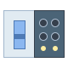


Use Case 1: Virtualized Customer Premise Equipment (CPE)
The functions in home APs are moved to a cloud in an ISP
Internet
Internet
ISP
Core router
vCore router
Virtual Functions
ISP
vFirewall
vDHCP
vNAT
vRouting
firewall
radio
Home network
DHCP
Home network
routing
NAT
radio

Slide 10




Use Case 2: Virtualized Evolved Packet Core (EPC)
The network components are virtualized as VNFs
Internet
Internet
VNFs
Cloud
PCRF
PCRF
P_GW
P_GW
EPC
S-GW
MME
S-GW
MME
Access Network
User Equipment

Slide 11
Use Cases Ranked

Slide 12
Agenda
Why NFV?
NFV works with SDN
Service function chain (SFC)
Open platform for NFV (OPNFV)
Virtual machine management with OpenStack
Virtual function management with OpenNF
High speed VNFs with SR-IOV

Slide 13
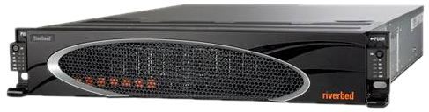

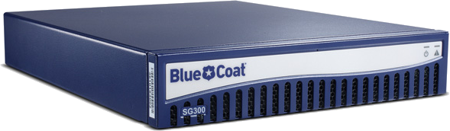

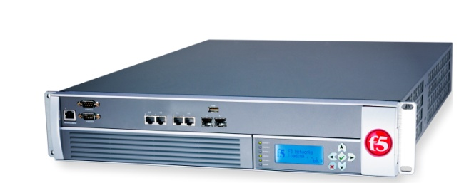


Network functions (NFs)
Perform sophisticated stateful actions on packets/flows
WAN optimizer
Caching proxy
Intrusion detection
system (IDS)

Slide 14

NFV works with SDN
NFV → dynamically allocate NF instances
SDN → dynamically reroute flows
Dynamic reallocation of packet processing
WAN optimizer
Caching proxy
Xen/KVM
Intrusion detection
system (IDS)

Slide 15

Example: elastic NF scaling
Satisfy performance SLAs
Minimize operating costs
Accurately monitor traffic
CPU
Packet loss

Slide 16
NFV v.s. SDN
 | NFV | SDN
Approach | Service/Function Abstraction | Networking Abstraction
Formalization | ETSI | ONF
Advantage | Promises to bring flexibility and cost reduction | Promises to bring unified programmable control and open interfaces
Protocol | Multiple control protocols (e.g. SNMP, NETCONF) | OpenFlow is de-facto standard
Applications run | Commodity servers and switches | Commodity servers for control plane and possibility for specialized hardware for data plane

Slide 17
NFV v.s. Cloud v.s. SDN

Slide 18
Agenda
Why NFV?
NFV works with SDN
Service function chain (SFC)
Open platform for NFV (OPNFV)
Virtual machine management with OpenStack
Virtual function management with OpenNF
High speed VNFs with SR-IOV

Slide 19

SFC High Level Architecture
Service Function Chain:
The intended set of abstract service functions that must be traversed by the classified packets and the order of traversal
E.g. DPI followed by parental control
Service Function Path:
The actual instances of services traversed or specific instantiation of a service chain
Classifier:
Determines what traffic needs to be chained based on policy

Slide 21
Notes:
Encapsulate

Slide 23
Agenda
Why NFV?
NFV works with SDN
Service function chain (SFC)
Open platform for NFV (OPNFV)
Virtual machine management with OpenStack
Virtual function management with OpenNF
High speed VNFs with SR-IOV

Slide 24
NFV Architecture
NFV Orchestrator
Virtual Network Functions (VNFs)
VNF Manges
VNF Manges
VNF 1
VNF 2
VNF 3
VNF n
VNF Manager(s)
Virtual Computing
Virtual Storage
Virtual Network
Virtualized Infrastructure Manager (VIM
Virtualization Layer
Computing Hardware
Storage Hardware
Network Hardware
Network Function Virtualization Infrastructure (NFVI)
NFV Management and Orchestration (MANO)

Slide 25
Introduction to OPNFV
OPNFV is a carrier-grade, integrated, open source platform to accelerate the introduction of new NFV products and services.
The goals of OPNFV
Develop an integrated and tested open source platform
Meet the needs of user community
Contribute to and participate in relevant open source projects
Establish an ecosystem for NFV solutions based on open standards and software

Slide 26
ETSI NFV Architecture Framework
NFV Orchestrator
OPNFV primarily focuses on NFVI
Virtual Network Functions (VNFs)
VNF Manges
VNF Manges
VNF 1
VNF 2
VNF 3
VNF n
VNF Manager(s)
Virtual Computing
Virtual Storage
Virtual Network
Virtualized Infrastructure Manager (VIM
Virtualization Layer
Computing Hardware
Storage Hardware
Network Hardware
Network Function Virtualization Infrastructure (NFVI)
OPNFV Scope

Slide 27
OPNFV Releases
Release | Version | Release Date
Gambia | 7.2 | 1/28/2019
Fraser | 6.2 | 6/29/2018
Euphrates | 5.1 | Mon, 12/18/2017
Danube | 3.0 | Mon, 7/17/2017
Colorado | 3.0 | Mon, 11/14/2016
Brahmaputra | 3.0 | Fri, 04/29/2016
Arno | SR1 | Thu, 10/01/2015

Slide 28
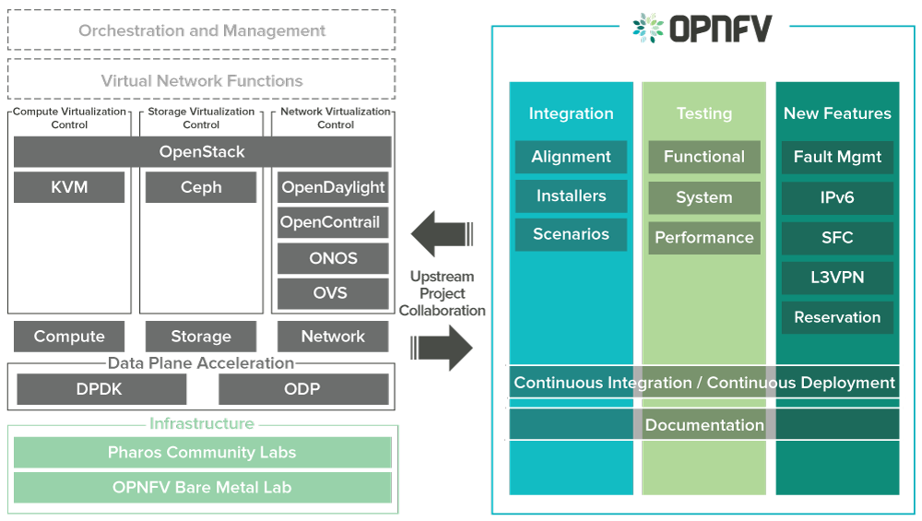
OPNFV Overview
There are three scopes in OPNFV
Integrate open source projects for NFV
Add new features other than the feature provided by integrated Projects
Provide tools to test the system performance
Notes:
DPDK = Intel data plane development kit, add text to describe the point

Slide 29
OPNFV: Integration
OPNFV integrate open source projects
Notes:
DPDK = Intel data plane development kit

Slide 30
OPNFV: Testing
Functional Testing (Functest suites)
VIM (Virtualized Infrastructure Manager)
Controllers
Features
VNF
Kubernetes
System Limitation Testing
Bottlenecks testing for VMs
Bottlenecks testing for Docker
Performance Testing
Storage performance: StorPerf
Network performance: VSPERF
Notes:
OPNFV提供了很多工具來對整個NFV系統做testing, 包含VM資源管理系統(指openstack), SDN controller…等等在功能是否正常(Kubernetes是container的管理系統), 另一類的工具是用來測系統效能的,包含VM的執行速度, container的執行决度, 最後一類工具是測試儲存設備的速度, 以及網路的傳輸速度(頻寬)

Slide 31
Agenda
Why NFV?
NFV works with SDN
Service function chain (SFC)
Open platform for NFV (OPNFV)
Virtual machine management with OpenStack
Virtual function management with OpenNF
High speed VNFs with SR-IOV

Slide 32
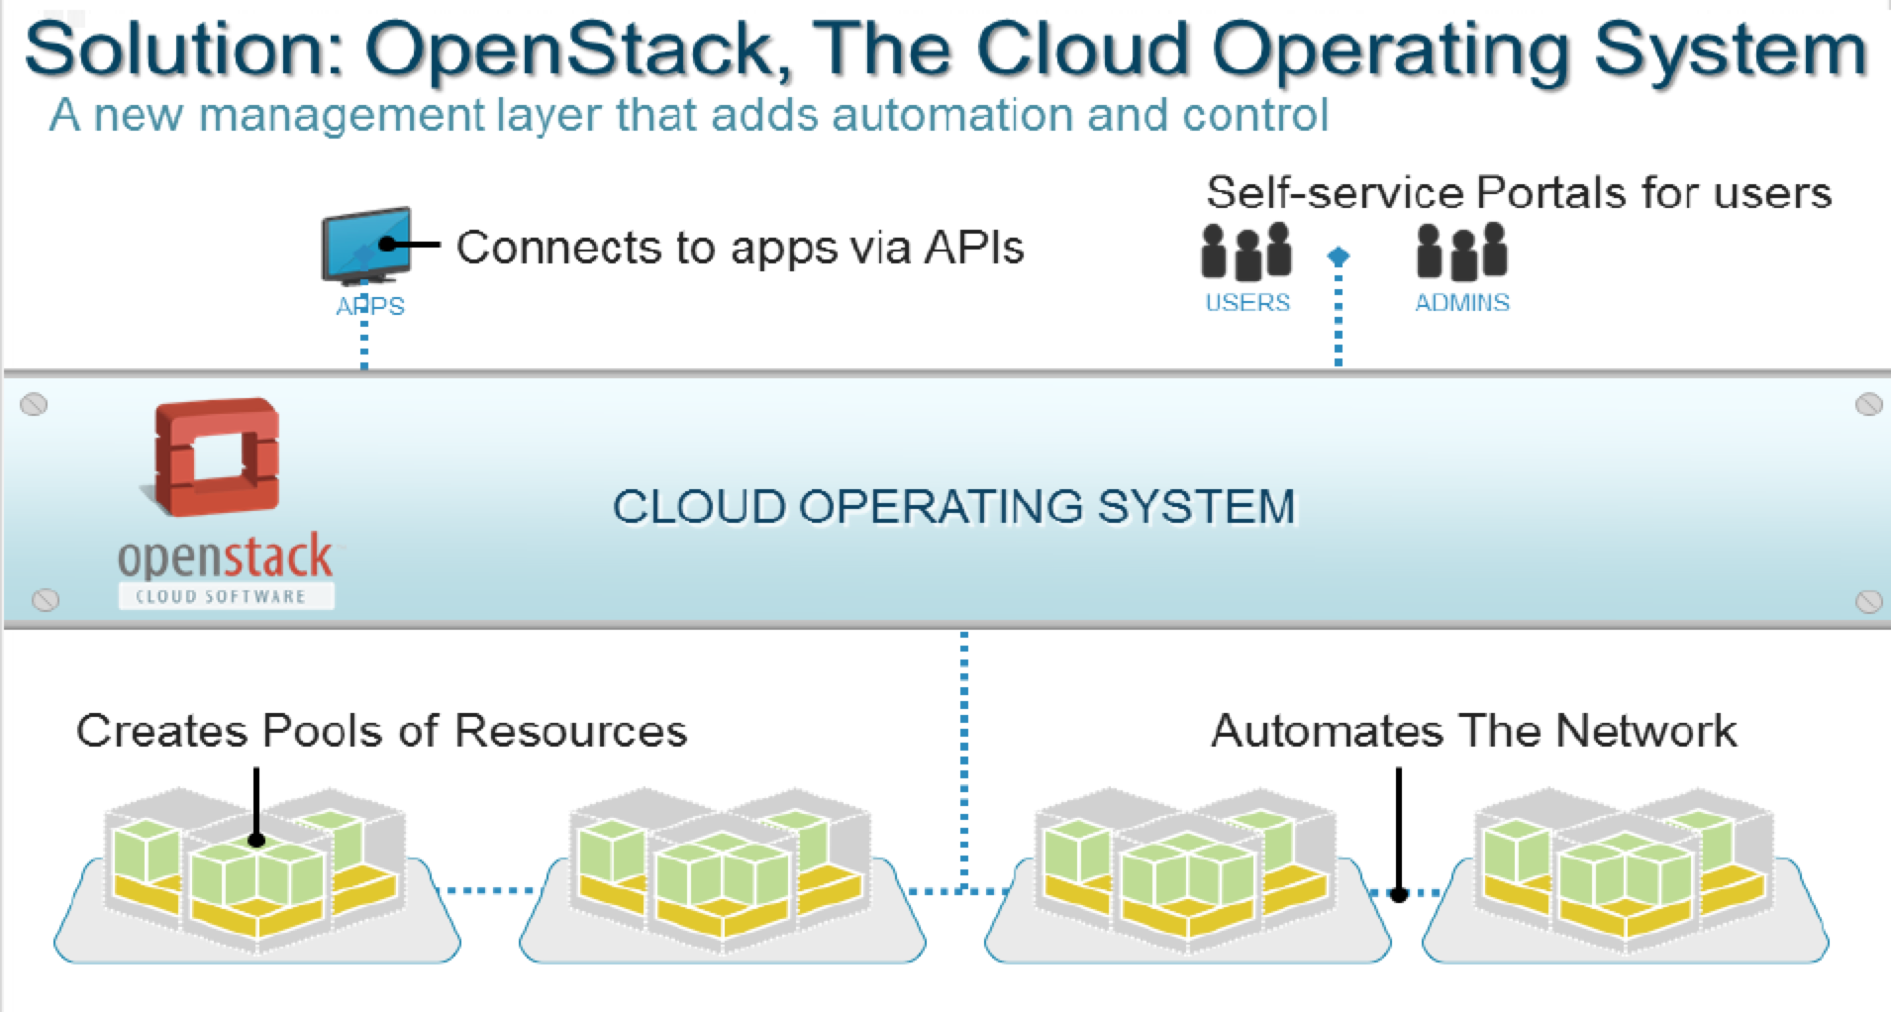
OpenStack
OpenStack is one of the major part of OPNFV
Similar to OpenFlow, OpenStack relies on a controller to manage infrastructure and provide north-bond API for cloud users

Slide 33
OpenStack Components
OpenStack includes several projects
NOVA
NEUTRON
CINDER
To implement services and associated libraries to provide massively scalable, on demand, self service access to compute resources, including bare metal, virtual machines, and containers.
OpenStack Neutron is an SDN networking project focused on delivering networking-as-a-service (NaaS) in virtual compute environments.
Cinder is a Block Storage service for OpenStack. It virtualizes the management of block storage devices and provides end users with a self service API to request and consume those resources without requiring any knowledge of where their storage is actually deployed or on what type of device.

Slide 34
OpenStack Components
OpenStack includes several projects
GLANCE
KEYSTONE
SWIFT
Glance image services include discovering, registering, and retrieving virtual machine images.
Keystone is an OpenStack service that provides API client authentication, service discovery, and distributed multi-tenant authorization by implementing OpenStack’s Identity API
Swift is a highly available, distributed, eventually consistent object/blob store. Organizations can use Swift to store lots of data efficiently, safely, and cheaply.

Slide 35
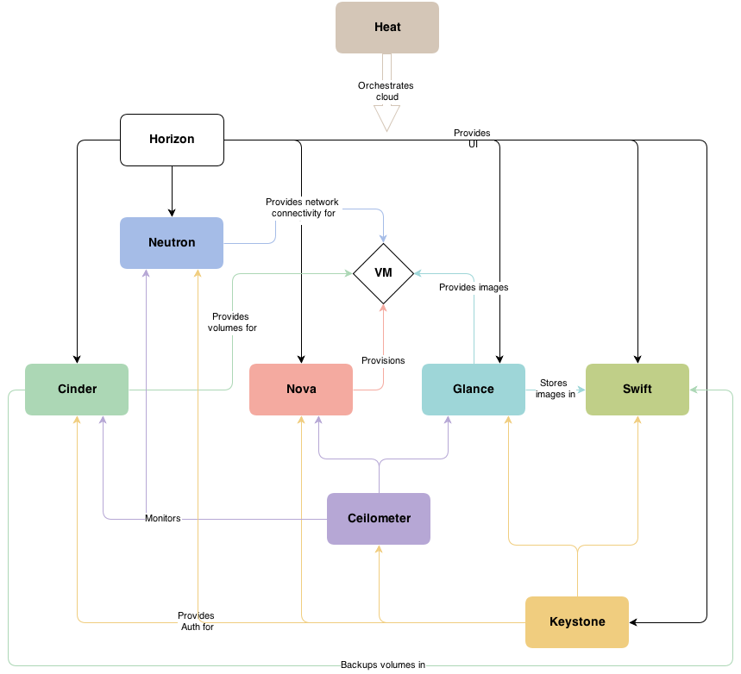
OpenStack Components
OpenStack includes several projects

Slide 36

Nova: Computing Manager
Manages computing resources for VMs or containers
NOVA
Hypervisor e.g. KVM

Slide 37
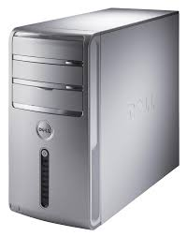
NOVA: Availability Zones
We can aggregate compute nodes as available zones
We can specify which zone to launch the VMs
Zone 2: Larger MEM
Zone 1: Fast CPU
Zone 3: DPDK Enabled
Notes:
Add text

Slide 38

NEUTRON: Network Manager
Manage packet forwarding and virtual networks
VMs or containers
NEUTRON
Open vSwitch or Linus bridge
Network Interface card
Internet

Slide 39
NEUTRON: OVS v.s. Linux Bridge
There are two options in Neutron to connect to VMs: OVS and Linux bridge
OVS:
Support OpenFlow
Required by DPDK
Difficult to install
Linux bridge
Simple and easy to install
Cannot support OpenFlow

Slide 40
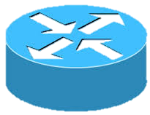
Neutron: Virtual Networks
Clients can create their own subnets and connect them to a cloud network
Inter-subnets
Private Subnet 2
10.1.1.0/24
VM
Private Subnet 1
172.16.1.0/24
Cloud Network
192.168.100.0/24
VM
10.1.1.4
172.16.1.3
Floating IP
192.168.100.123
vRouter
vRouter

Slide 41
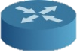
NEUTRON: Inter-subnet Communication
However, long route and floating IP translation are overhead and make throughput drop
192.168.100.123
192.168.100.123
Floating IP
172.16.1.3
10.1.1.4
iPerf
Server
iPerf
Client
VM
VM
V
V
OVS
OVS
L3 Agent
Compute node
Compute node
Network node
Host
Host 1
Host
Public Net: 140.96.102.0/24
Subnet 1: 172.16.1.0/24
Subnet 2: 10.1.1.0/24
Notes:
這張投影片對應到前一張, VM是運行在compute node, 而vRouter是運行在network node中,而network node和compute node可能是不同的實體電腦. 當VM要傳封包給不同虛擬網路的VM時,需經過vRouter所以封包會先送到network node,再送回compute node (紅色箭頭是封包傳輸的方向). 封包在經過vRouter時,會做floating IP的轉換(發送端把封包傳向public floating IP, vRouter要把這個public IP傳成destination的private IP,再傳到其虛擬網路中

Slide 42
NEUTRON: Availability Zones
Nodes are grouped as availability zones for vRouters
L3 agents are deployed in each compute node to enable vRouter availability zones
V
vRouter
L3 Agent
L3 Agent
Network node
L3 Agent
Network node
Host
Network node
Host
Host
Zone 2
Zone 1
Notes:
VM可以藉由設定其availability zone來指定此VM要被運行在那一台實體伺服器中, vRouter也是同樣的情況,我們可以藉由設定指定vRouter要運行在那一台實體機器之中.

Slide 43

NEUTRON: Define Router Availability Zones
An administrator defines vRouter availability zones
We setup the attribute “availability_zone” in neutron.conf to define the availability zone
availability_zone = Zone-2
availability_zone = Zone-2
availability_zone = Zone-1
Administrator
L3 Agent
L3 Agent
Network node
L3 Agent
Network node
Host
Network node
Host
Host
Zone 2
Zone 1
Notes:
因為目前Openstack的GUI還不支援vRouter的availability zone,因此,我們只能修改neutron.conf來指定每台實體機器是屬於那一個availability zone.

Slide 44

NEUTRON: vRouter Placement
Users can put VM and vRouter to the same availability zone for shorter latency
User
VM 1
V
VM 2
OVS
L3 Agent
Compute node
Network node
OVS
L3 Agent
Host
Compute node
Network node
Host
Zone 1
Notes:
因為VM和vRouter都可以藉由設定availability zone來指定要運行在那一台實體機器,因此,我們可以將彼此有傳輸需求的VM和vRouter放在同一台實體機器之中,可以大大地減少傳輸latency,因為封包被送到實體網路的傳輸速度遠比在同一台實體機器內的傳輸要慢得多

Slide 45
OpenStack Nodes
Traditionally, different nodes are deployed in different physical machines (hosts)
Inter-subnet communication should go a network node → higher latency
We combine the functions of compute and network nodes
Control node
Compute node
Network node
OpenStack Controller
Running VMs
vRouter to connect VMs in different virtual subnets

Slide 46
The Steps to Launch a VM
There are some steps to boot up a VM
VM Image
I
I
I
VM Instance
I
Image DB
Compute Node
Prepare an Image for the VNF
Register the image with the platform
Activate VNF instance in a compute node
Create Networks
Connect the VMs to the Networks

Slide 47
Agenda
Why NFV?
NFV works with SDN
Service function chain (SFC)
Open platform for NFV (OPNFV)
Virtual machine management with OpenStack
Virtual function management with OpenNF
High speed VNFs with SR-IOV

Slide 48


OpenNF: States in NF
Each NF includes several states
How to manage the state in controller?
Src IP = 140.109.21.50 | Deny
Dst port = 80 | Accept
http://www.youtube.com | Content
http://www.ncu.edu.tw | Content

Slide 49
OpenNF: SLAs + cost + accuracy: What do we need?
Quickly move, copy, or share internal NF state alongside updates to network forwarding state
Guarantees: loss-free, order-preserving, …
✓
✓
✓
…
1
2
3
…
Also applies to other scenarios

Slide 50
OpenNF overview
Control Application
move/copy/share state
OpenNF Controller
NF State Manager
Flow Manager
export/import State

Slide 51
OpenNF: State Movement
Control Application
Flow Manager
move (port=80, Bro₁, Bro₂)
forward(port=80, Bro₂)
NF State Manager
get(per, port=80)
put (per, Chunk1)
del(per, port=80)
[Chunk1]
put (per, Chunk2)
[Chunk2]
Bro₁
Bro₂
Also provide copy and share

Slide 52
Agenda
Why NFV?
NFV works with SDN
Service function chain (SFC)
Open platform for NFV (OPNFV)
Virtual machine management with OpenStack
Virtual function management with OpenNF
High speed VNFs with SR-IOV

Slide 53
NFV Performance
Packets are copied between different memory spaces between kernel and user space. It results in high latency

Slide 54
Data Path Development Kit (DPDK)
By pass host kernel space to reduce the memory copy latency
OVS is used to forward packets to VMs
VM
VM
VM
With DPDK, packets can bypass kernel space
VM
VM
VM
User Space
User Space
OVS
OVS
Kernel Space
Kernel Space
Without DPDK, packets are processed by network stack in Kernel
NIC
NIC
Packet
Packet
Notes:
左圖是傳統Openstack基本的配置, 封包進入NIC會先被送到Kernel space,因為OVS運行在Kernel之中, 然後OVS會根據packet head將packet forward到VM,而VM是運行在user space,所以封包會被從kernel space copy到user space,再送到VM. 過多的memory copy和os interrupt造成很高的latency. 因此右圖運用了DPDK的技術, OVS只運行在user space,且封包直接進入user space中, 繞過kernel space, 因此可以減少memory copy和os interrupt的次數, 減少latency

Slide 55
Signal Root I/O Virtualization ( SR-IOV)
SR-IOV NIC includes a L2-switch, so it don’t need OVS to forward packets anymore
Packets further by-pass the user space of host to reduce latency
VM
VM
VM
User Space
Kernel Space
L2 switch
SR-IOV NIC
Packet
Notes:
再更進一步, SR-IOV是新的NIC技術,內建一個硬體switch可以做forwarding,所以完全不需要軟體OVS做forwarding的動作,因此可以繞過kernel space和user space,直接由NIC將封包送到VM中,可以更進一步減少NFV的latency

